Slide 1




At Home IOP Monitoring iCare Home
March 9, 2021

Slide 2


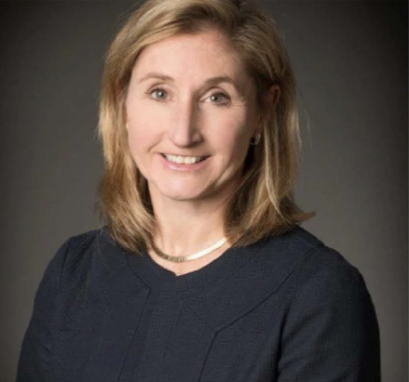
Why we started MyEyes
MyEYES is dedicated to helping you better manage your Glaucoma with access to the personal tonometer, iCare HOME.
Cofounders
Paul Margolis
Barbara Wirostko MD FARVO

Slide 3
Glaucoma:
Progressive Optic Neuropathy
IOP is still the the only modifiable risk factor
Clinical studies have demonstrated that lowering IOP = slows disease progression
We treat and lower both elevated IOP as well as normal IOP IF there is progression of optic nerve damage
It is well known that glaucoma progresses despite well managed IOP¹
1. Heijl et al. Arch Ophthalmology 2002

Slide 4
IOP Fluctuation:
Isolated in office IOP may no longer be sufficient
IOP has diurnal and nocturnal variability and fluctuations
  Varies with positioning (supine), sleep, cortisol levels, Nitric oxide, and exercise (yoga)
IOP has been limited to a single time point in office during the day
  IOP measured over a couple of seconds (31,536,000 seconds in a year)
Various devices have been developed to try to capture IOP variability
  Trigger Fish Contact lens (FDA).
  Implandata introduced the first implantable continuous monitoring device: the Eyemate
    Permanent and not FDA cleared
  iCare Home (patient access – easy use and FDA cleared)

Slide 5
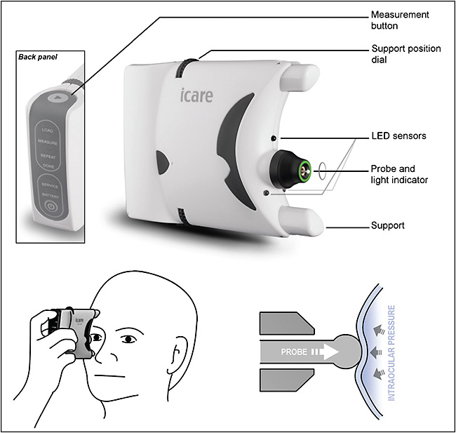
In 2017 - FDA cleared a home device: iCare Home Tonometry
  “Prescription device intended as an adjunct to routine clinical monitoring of IOP of adult patients”¹
  Currently only available for purchase, about $2500/ device
  Do patients need to own the device?
1. FDA 510K approval 2017
Figure 1. Diagram of an iCare Home (iCare Finland Oy).

Slide 6
iCare Home detection ability: identify IOP spikes
We have come to accept and use rebound iCare Tonometers in our offices
  Validated IOP method with good reliability
  Good approximation with Goldmann Applanation Tonometry (GAT)¹
iCare Home has similar IOP measurements as office based tonometry²
1. Badakere et al. Ophthalmology Glaucoma, 2020
2. Tatham et al. Ophthalmology Glaucoma, 2020

Slide 7
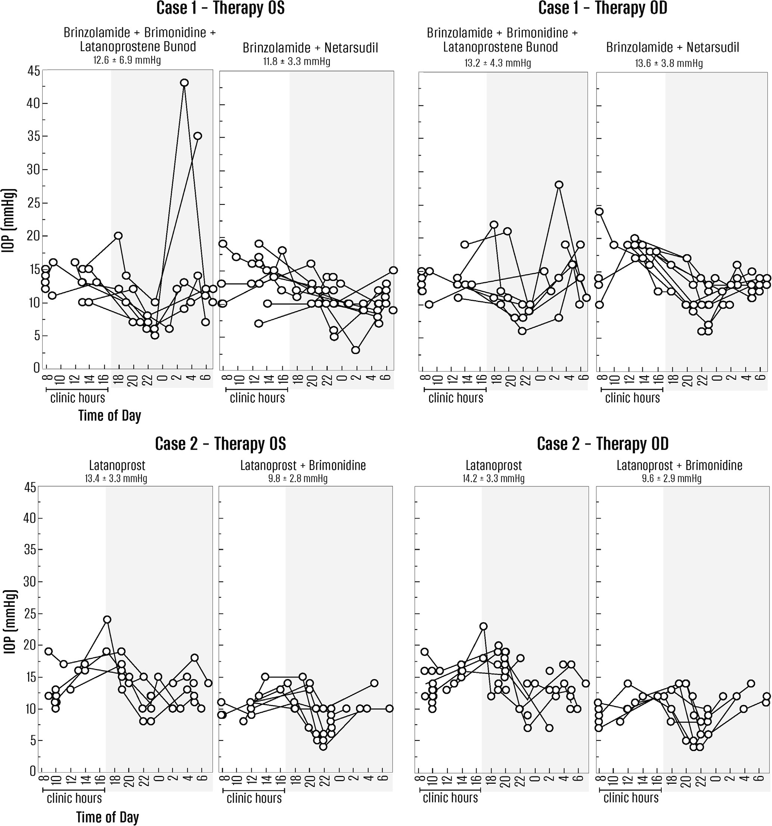
Two cases of “controlled” glaucoma patients.
Case 1 – 72 yr old surgeon with Glaucoma,
IOP on average mid teens during the day, spikes to 43 mmHg OS and 28 mmHg OD at night (Rojas et al.)
Rojas et al, Ophthalmology Glaucoma, Sept/Oct 2020

Slide 8
Case #2
  Case 2 (Utah).
  67 yo male suffered from “controlled” normal tension glaucoma for years, IOP on average 12-14 mmHg in the office OU, on maximum medical therapy
  BCVA 20/20, VF loss into fixation
  With the iCare, we learned his IOP was spiking into high 20s at night
  Result – Surgery
  Question – how long did we all believe he was controlled ?

Slide 9

Patient Testimonial
Peter Farina PhD
We offer a solution that enables patients to better manage their vision threatening disease
  In the comfort of their home
  With the ability to detect IOP spikes that would otherwise go undetected
Large unmet need – no competition for sales and or rentals in the US
  iCare US will not sell to patients

Slide 10
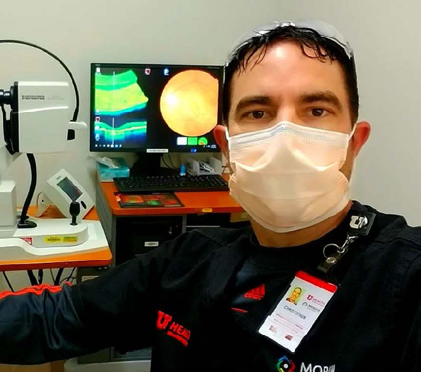
Telemedicine
  Usefulness of iCare Home in
  Telemedicine Workflow to
  Detect Real-World Intraocular
  Pressure Response to Glaucoma Medication Change
    Response to Surgery or Laser
  Covid inability to
  get to the office

Slide 11
MyEYES.net all the necessary information on the website info@myeyes.net
Rental service for the iCare Home, shipped directly to the patient
  A prescription emailed from the doctor to info@myeyes.net
    Upload easily on the website
  iCare device shipped directly to the patient nationwide – 2-3 days
  Real time information – raw data, graphs and average readings
    Available to the MD & patient
  Ease of use and real time support
  No cost to the referring doctors
  First week $250, $150 weekly thereafter.
    HSA/flex spending as home device monitoring and a diagnosis

Slide 12
Our Ask!
We need help developing:
  The digital/social media marketing
  The DTC marketing (patients =customers)
We have an outreach to the MDs who are the enablers
  Could use help getting access to the primary care and the ODs
  Understanding the COCA
Who are our customers and how do we market to them?

